Slide 1

Welcome
Agile Testing
Notes:
Mandatory
ACTION: Adjust title to fit your course.

Slide 2
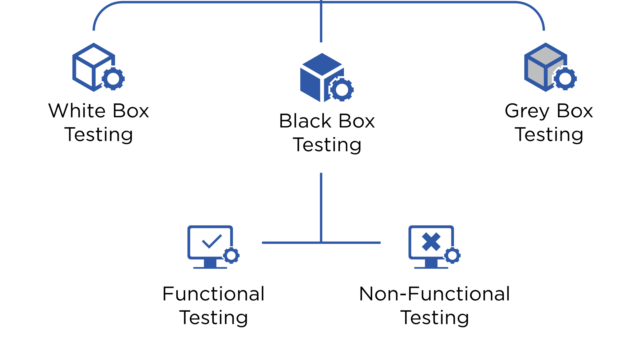
What is software testing?
Software testing is the act of:
Examining the artifacts and the behavior of the software under test by validation and verification.
Software testing can also provide an objective, independent view of the software to allow the business to appreciate and understand the risks of software implementation.
- Wikipedia
Notes:
Testing in an Agile environment is an integral part of the software development process. Agile methodologies, such as Scrum, Kanban, and Extreme Programming (XP), emphasize delivering high-quality software through iterative and incremental development. Testing in an Agile environment follows certain principles and practices that promote early testing, continuous feedback, and collaboration between developers and testers

Slide 3
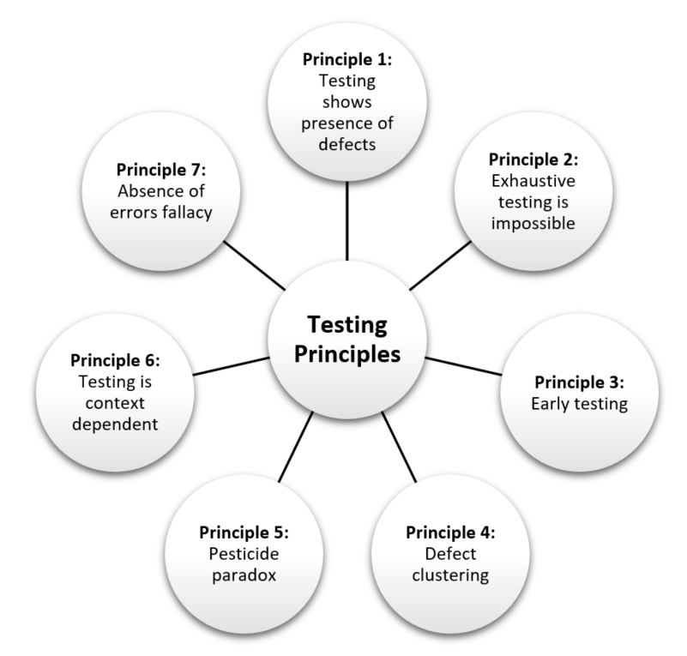
Software testing principles
Myth: Principles are just for reference. I will not use them in practice.
Notes:
Software testing principles provide guidelines and best practices for conducting effective testing activities throughout the software development lifecycle. These principles help ensure that software is thoroughly evaluated for quality, functionality, and reliability. Here are some fundamental software testing principles:
Testing Shows the Presence of Defects: The primary goal of testing is to identify defects or issues in the software. A successful test is one that uncovers defects, rather than proving that the software is defect-free.
Exhaustive Testing Is Impossible: It's practically impossible to test every combination of inputs, conditions, and scenarios due to the complexity of modern software. Testing efforts should be focused on areas with the highest risks and potential impact.
Early Testing: Testing activities should begin early in the software development lifecycle. Detecting and addressing defects early reduces the cost of fixing issues later.
Defect Clustering: A small number of modules or components typically contain the majority of defects. Focusing testing efforts on these areas can yield significant results.
Pesticide Paradox: Repeated testing with the same set of test cases can lead to the omission of new defects. Regularly updating and refreshing test cases is essential to uncover new issues.
Testing Is Context-Dependent: Testing approaches and techniques vary based on the project's context, such as requirements, technology, industry, and the development process.
Absence-of-Errors Fallacy: The absence of defects found during testing doesn't imply that the software is defect-free. It simply indicates that the defects discovered were insufficient to trigger further testing.

Slide 4
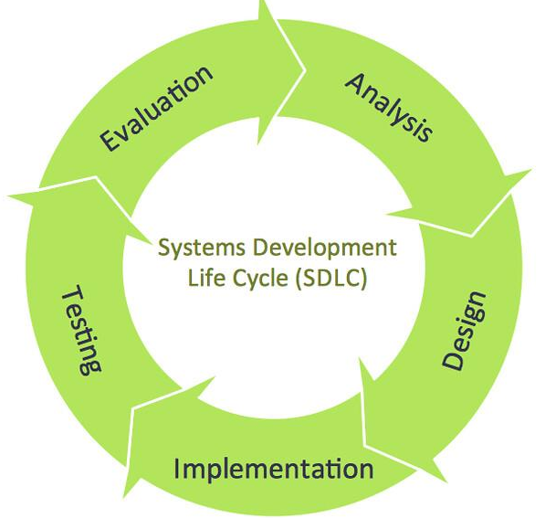
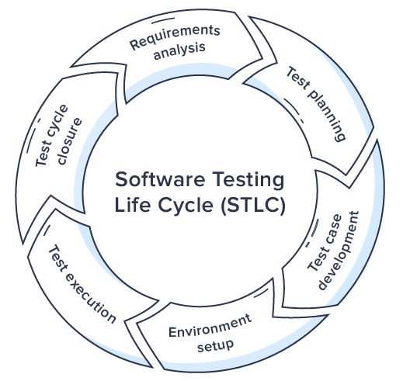
Software Testing Lifecycle
Notes:
Mandatory
ACTION: Adjust bullets as per your course.
In this section, discuss the structure of the course—exercises, labs, etc.
Also, discuss any resources students will be using.

Slide 5
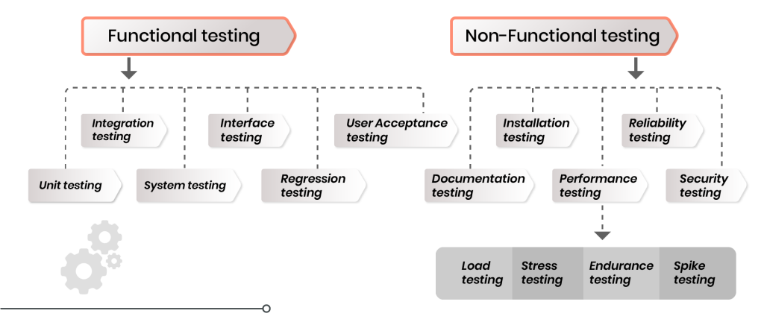
Types of software testing
Notes:
There are various types of software testing that address different aspects of a software application's quality, functionality, and performance. These testing types are designed to uncover defects, verify functionality, and ensure that the software meets the specified requirements. Here are some common types of software testing:
Unit Testing: This involves testing individual components or modules of the software in isolation. Unit tests verify that each unit of code works as intended and meets its design specifications.
Integration Testing: Integration tests focus on interactions between different components or modules of the software. The goal is to identify any issues that arise when these components are integrated.
Functional Testing: Functional testing verifies that the software's features and functions work as expected, based on the defined requirements. It involves testing various scenarios and inputs to ensure correct behavior.
Regression Testing: Regression testing ensures that recent code changes or updates do not negatively impact existing functionalities. It involves retesting previously tested areas to catch regressions or unintended consequences.
User Acceptance Testing (UAT): UAT is conducted by end-users to validate whether the software meets their requirements and expectations. It helps ensure that the software is ready for release to users.
Performance Testing: Performance testing assesses how well the software performs under various conditions, such as load, stress, and scalability. It aims to identify bottlenecks, performance issues, and resource limitations.
Security Testing: Security testing examines the software's vulnerabilities and weaknesses to ensure that it is resistant to unauthorized access, attacks, and data breaches.
Usability Testing: Usability testing evaluates the software's user-friendliness and ease of use. It focuses on aspects such as user interface design, navigation, and user interactions.
Compatibility Testing: Compatibility testing checks how well the software performs across different devices, browsers, operating systems, and network environments.
Smoke Testing: Also known as build verification testing, smoke testing is a quick preliminary test to ensure that the software's critical functionalities are working after a new build or release.

Slide 6

Types of Tests

Slide 7
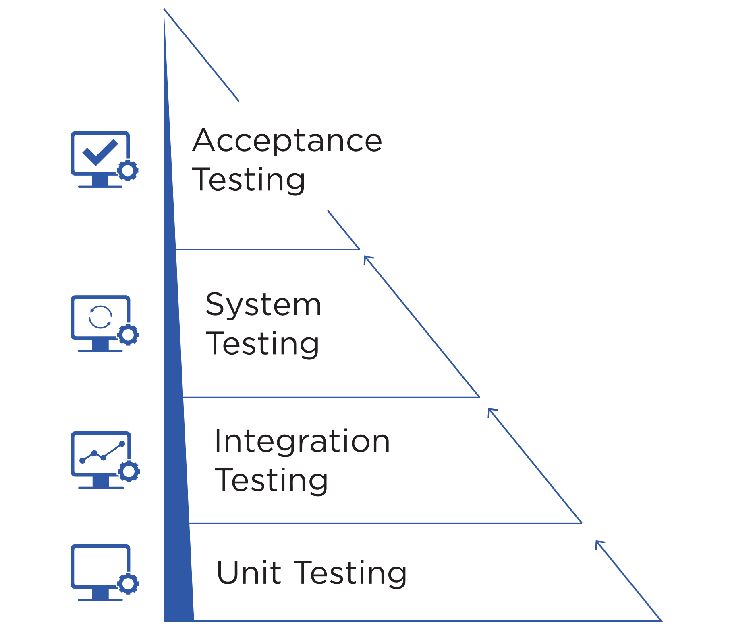
Unit Testing
Manual Tests
Usually written by developers
Uses Assertions
Testing smallest part of the system in isolation
Best Performance – execute early, often and within few seconds
Smallest scope - easier to locate and understand errors
Frequency – Every code check-in or pull request
Use of test doubles to replace dependencies – dummies, stubs, spikes, mocks
Increases confidence in changing/maintaining code
Notes:
Unit testing is a software testing practice in which individual components or units of code are tested in isolation to ensure that they function correctly. A unit refers to the smallest testable part of a software application, often a single function, method, or procedure. The primary goal of unit testing is to verify that each unit of code works as intended and meets its design specifications.
Unit testing significantly contributes to software quality by catching defects early in the development process. It helps ensure that individual units of code are reliable, functional, and meet the intended behavior. While unit testing focuses on the smallest code components, it plays a crucial role in building a solid foundation for the overall software application.

Slide 8
Middle Layer Testing
Manual Tests
Together called as service/API layer tests, also termed as “middleware layer”.
Component Tests: Look at individual components. Validates the functionality is working as expected with other components.
Integration Tests: Targets modules/features that integrate directly with other dependencies outside the application. Can be used as gating/staging from preprod to prod etc.
System Integration Tests: Large scale integration suite testing end-to-end workflows. Often coordinated across teams and unique to your application or system.
Notes:
Middle layer testing, also known as integration testing or component testing, is a type of software testing that focuses on verifying the interactions and interfaces between various modules, components, or services within a software application. The goal of middle layer testing is to ensure that different parts of the application work together seamlessly and produce the expected outcomes when integrated.
Middle layer testing is especially important in complex software applications where different components interact to provide specific features and functionality. By validating the integration points and interactions, middle layer testing helps prevent defects from propagating to higher-level testing stages and ensures the overall reliability of the software application.

Slide 9
Acceptance Testing
Manual Tests
Similar to integration tests in the sense that they test different parts of the application
End-to-end testing
Ensure high-level functionality works as expected or described and delivers business value
Maximum scope such as - logics, UI workflows, navigation, transitions, calculations, buttons, layouts etc.
Can be brittle or flaky and a lot of work to maintain
Test critical workflows
Notes:
Acceptance testing is a software testing phase that assesses whether a software application meets the specified requirements and is ready to be accepted by stakeholders, users, or customers. The primary objective of acceptance testing is to validate that the software satisfies user needs, works as intended, and aligns with the business goals.
Acceptance testing provides a final validation of the software's readiness for deployment. It helps ensure that the software meets user needs, is aligned with business objectives, and is free from critical defects. This phase bridges the gap between development and deployment, offering stakeholders confidence in the software's quality before it is launched to a wider audience.

Slide 10
Manual Testing
Manual Tests
Not regression testing
Experience + creativity
Learn about the system, discover defects & improve automated testing
Can be based on missions/test charter/persona
Covers scenarios which can’t be automated or are too complex to automate
Edge Scenarios for mission critical applications to prevent failure
Notes:
Manual testing is a software testing technique in which test cases are executed by human testers without the use of automated testing tools or scripts. It involves systematically going through the software application, interacting with its various features, and comparing the actual results with expected outcomes to identify defects and ensure its quality.
Despite its advantages, manual testing has limitations, such as being time-consuming for repetitive tests, less suitable for large-scale applications, and more prone to human errors. Automated testing is often preferred for long-term regression testing and executing repetitive tasks. However, manual testing remains valuable for exploratory, ad-hoc, usability, and initial testing, as well as for scenarios where human judgment and creativity are required.

Slide 11
Performance, Security, Scalability
Manual Tests
Performance Testing - Generating data or metrics on the performance of your application. E.g. – A tipping point where your application can’t take any more requests.
Security Testing - To check for vulnerability and security loopholes resulting in loss or unauthorized access of data. E.g.- PID (Personal Identification Information) of application users.
Scalability Testing - Testing of a software application to measure its capability to scale up or scale out in terms of any of its non-functional capability.
Performance
Security
Scalability
Notes:
Performance testing is a type of software testing that evaluates how well a software application performs under various conditions, such as different levels of user load, response times, and stress. The goal of performance testing is to ensure that the software meets specified performance criteria, remains stable, and performs adequately even when subjected to demanding scenarios.
Security testing is a type of software testing that assesses the security features and vulnerabilities of a software application to identify potential security risks and weaknesses. The goal of security testing is to ensure that the application is protected against unauthorized access, data breaches, and other security threats.
Scalability testing is a type of performance testing that evaluates how well a software application can handle increased workloads, user traffic, and data volume while maintaining its performance, responsiveness, and stability. The goal of scalability testing is to determine the application's ability to scale up or down based on changing demands without degrading its performance or causing failures.

Slide 12
Unit Testing

Slide 13
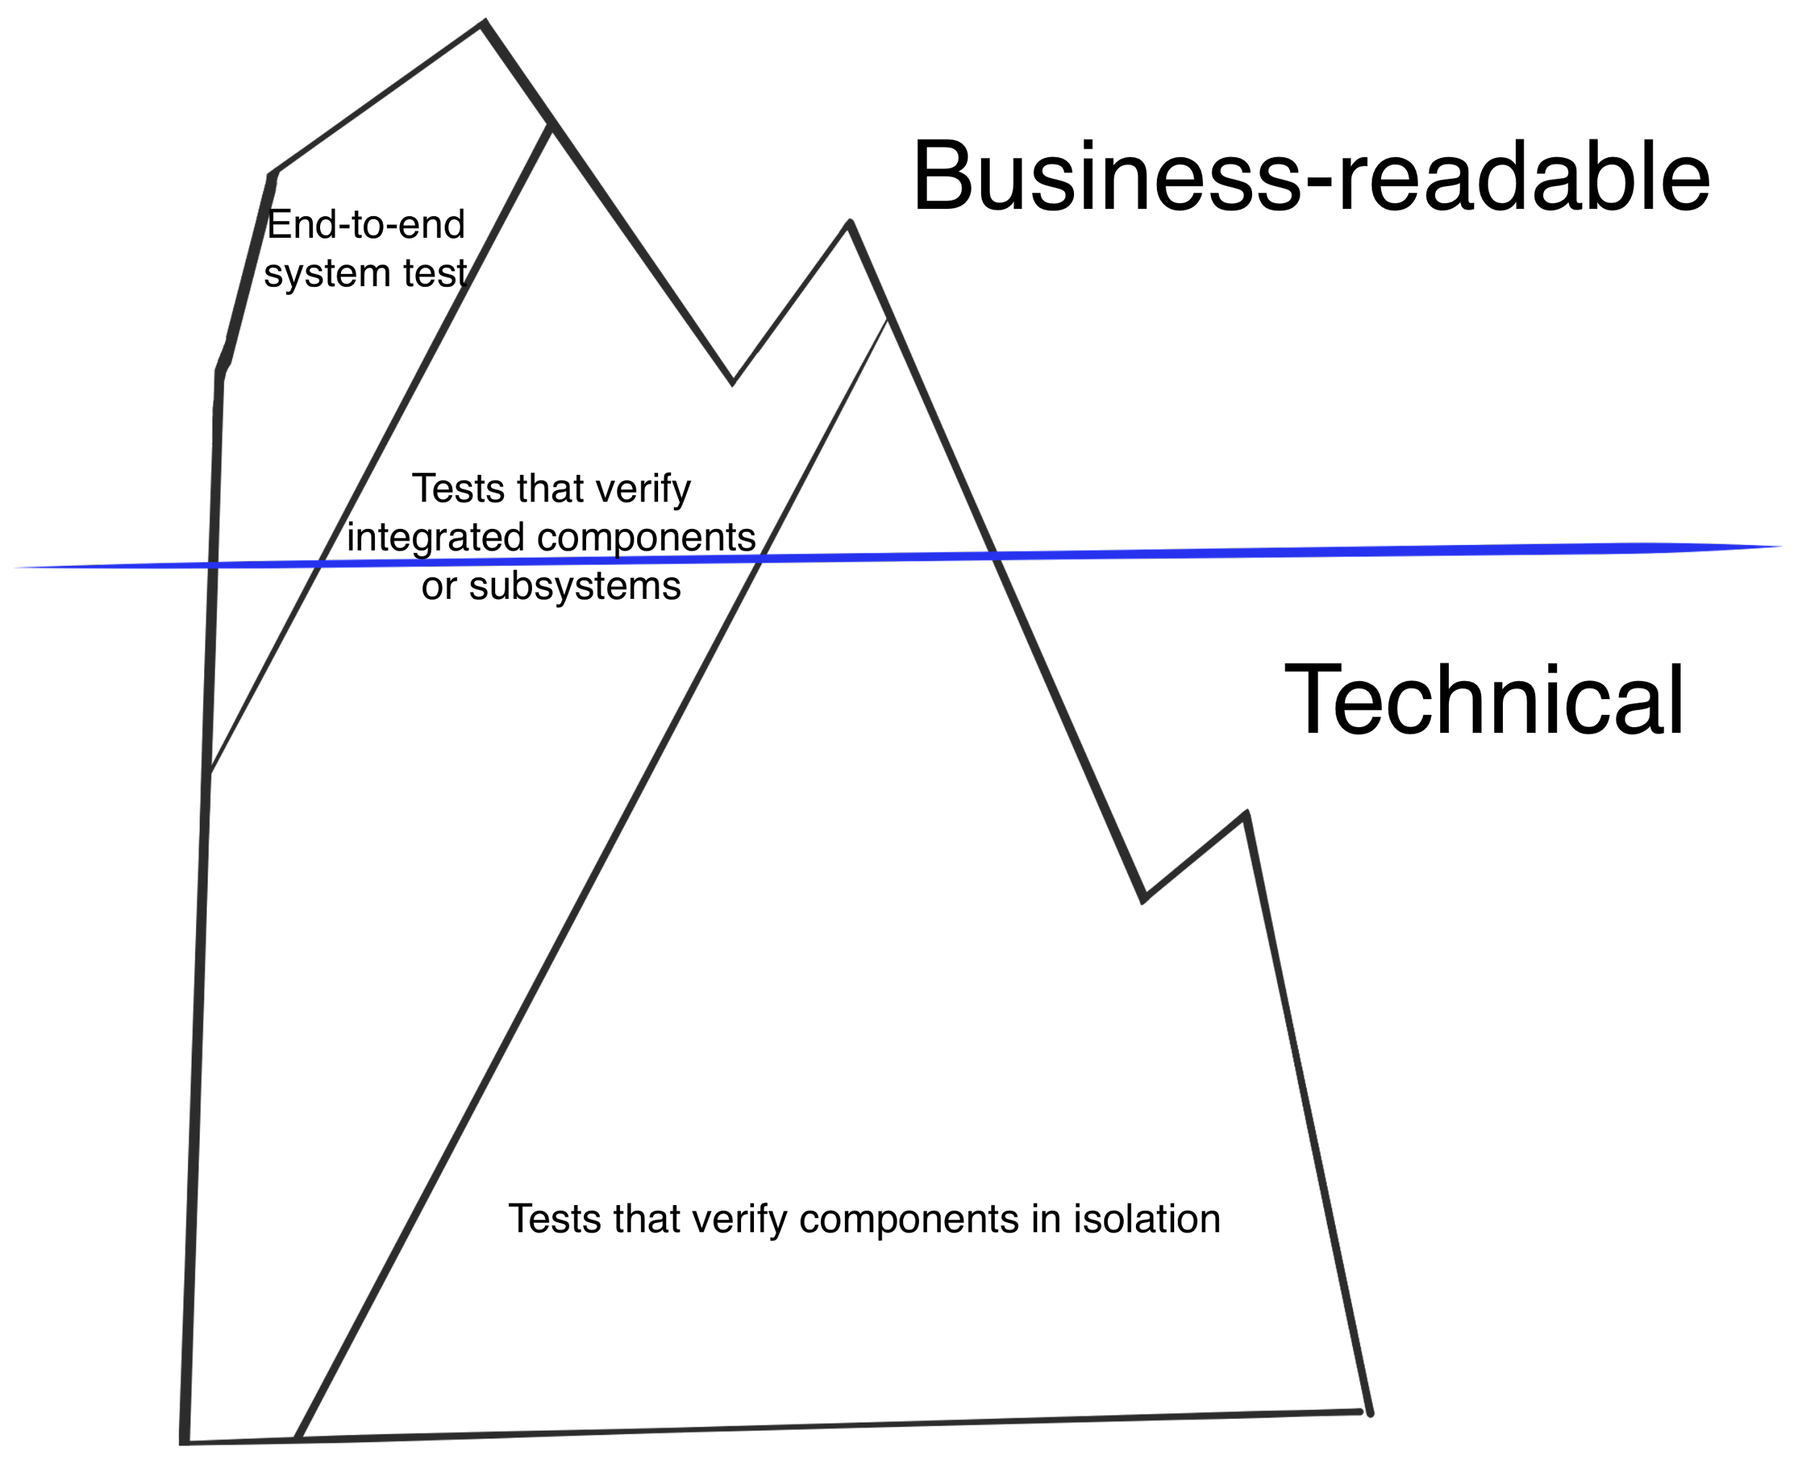
The Testing Iceberg

Slide 14
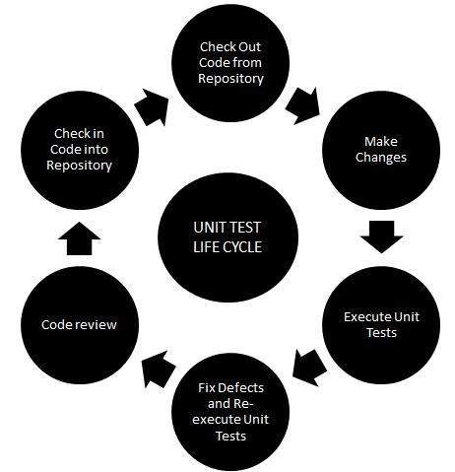
What is a unit test?
A unit is the tiniest testable component/functionality(unit) of the software. At this level, individual units of the software are tested.
Concerned with functional correctness & completeness of individual units of code
Usually has a few input(s) and a single output. One function may have multiple unit tests according to usage
E.g. – Classes, functions, procedures, interfaces
Primarily written and executed by the same person who writes code for that piece or component.
Ensures :
Code meets expectation & specification
Code continues to meet expectations over time: Avoiding regression
White box testing

Slide 15
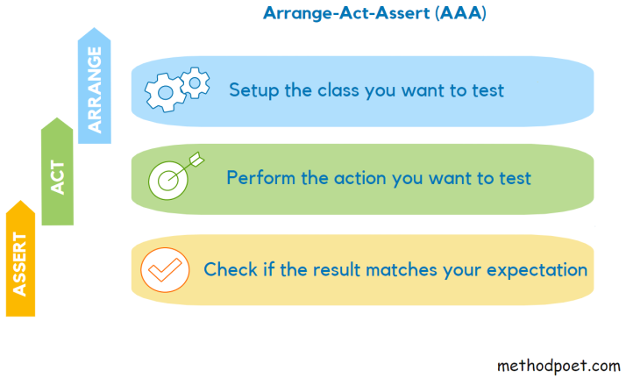
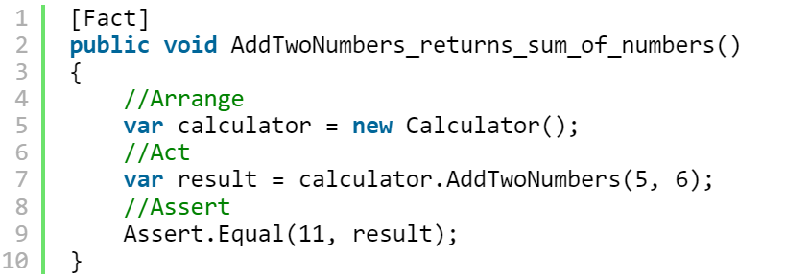
Unit test structure - AAA

Slide 16


Demo – Our first unit test
10 minutes
Instructions:
Check if the title of book is – “All the Light We Cannot See”
Steps:
- “Arrange“ an object of class “Book”
- “Act” by calling getTitle() method
- “Assert” the returned result
Notes:
Demo a JUnit test. If IDE not available, use notepad to demonstrate. Explain the test constructs
Example of a failing test
import org.junit.Test;
import static org.junit.Assert.*;
public class BookTest {
@Test
public void should_test_title_of_book() {
Book book = new Book("All the Light We Cannot See");
assertEquals("All the Light We Cannot See", book.getTitle());
}
private class Book {
public Book(String s) {
}
public String getTitle() {
return null;
}
}
}

Slide 17
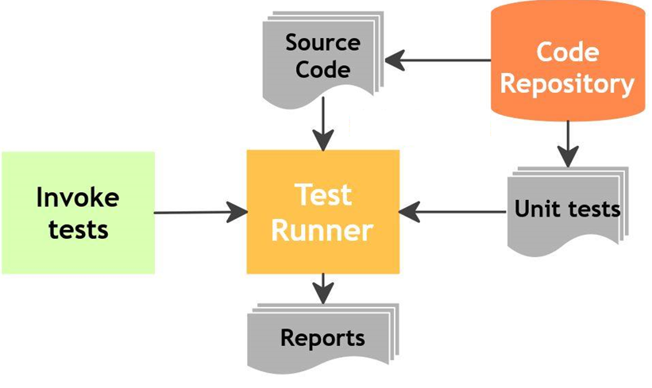
How was the first-code?
What did we just do?
What did you observe?
Did you understand the code?
What was new for you?
Notes:
Mandatory
ACTION: Adjust bullets as per your course.
In this section, discuss the structure of the course—exercises, labs, etc.
Also, discuss any resources students will be using.

Slide 18
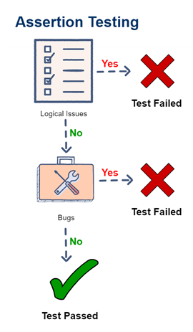
Assertion
Used to test a logical expression
At a binary level, assertion is just a Boolean expression – containing a true or false
Assertions are used to declare the expected behavior or outcome of a test
An assertion is true if the logical expression that is being tested is true and there are no bugs in the program.
Notes:
Mandatory
ACTION: Adjust bullets as per your course.
In this section, discuss the structure of the course—exercises, labs, etc.
Also, discuss any resources students will be using.

Slide 19
Why unit test?
Faster Debugging
Faster Development
Better Design
Excellent Regression Tool
Reduce future costs such as – bug fixes, maintenance, new additions etc.
Integration testing become much easier
Provides a living document of the system

Slide 20
Guidelines/Good Practices
Keep them small and fast (able to execute within seconds)
Should be fully automated
Simple to run
Measure the tests – code coverage
Fix failing tests immediately
Keep testing at unit level
Keep tests independent
Test the trivial cases too

Slide 21


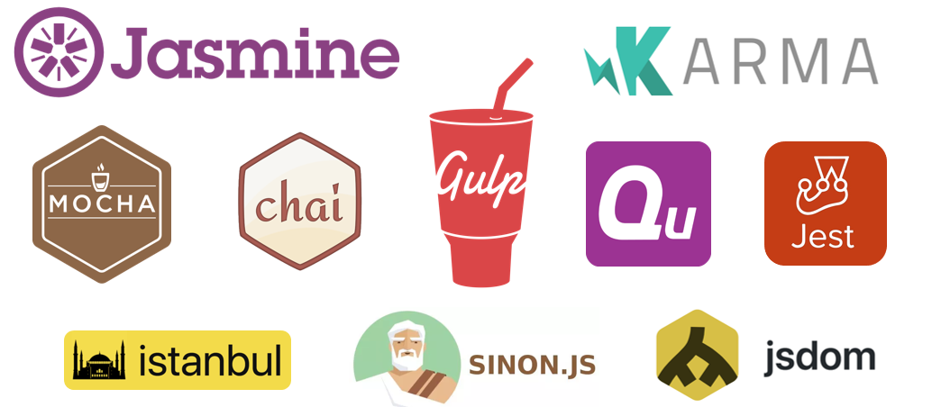

Unit test tools
And many more…

Slide 22
Activity – Write & execute few more unit tests
15-20 minutes
Instructions:
- Check ISBN of the book is – 1501173219
- Check publisher name is - Celadon Books
- Check the cost is $23.00

Slide 23
Testing in Agile – An Introduction

Slide 24
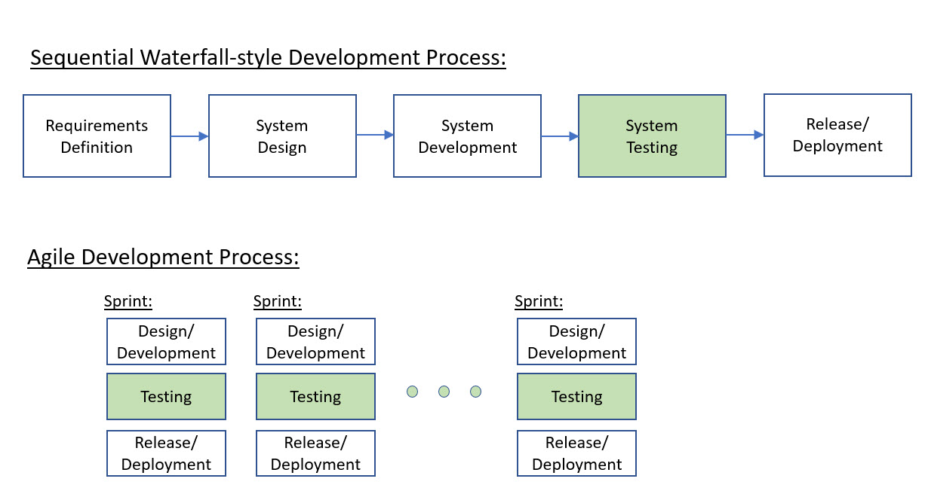
Agile Testing vs Traditional Testing

Slide 25
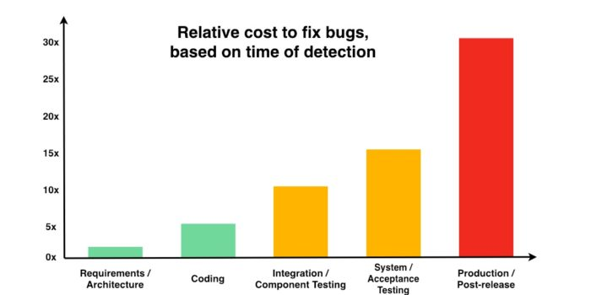
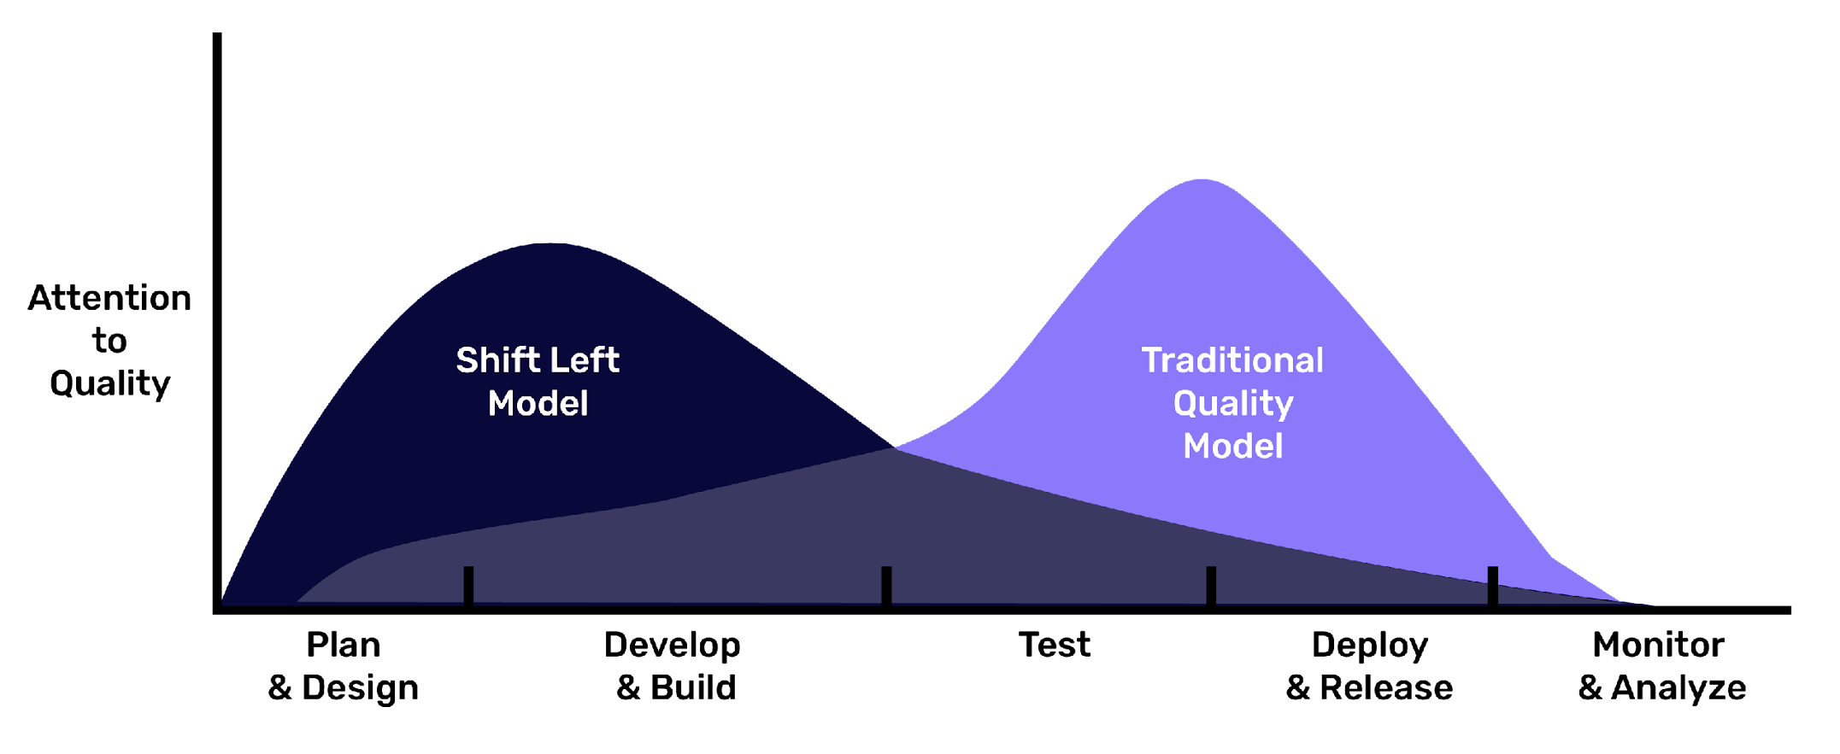
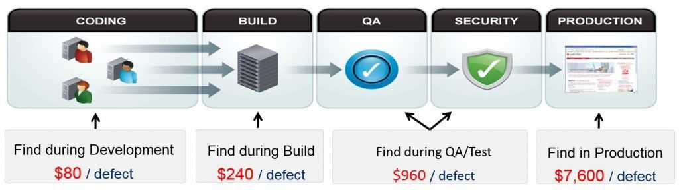
Shift left – why?
A research by Ponemon Institute, in 2017

Slide 26
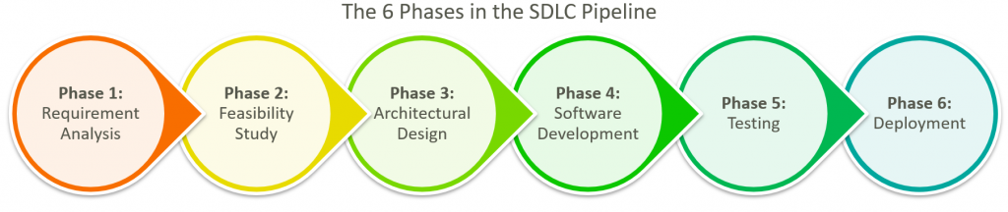
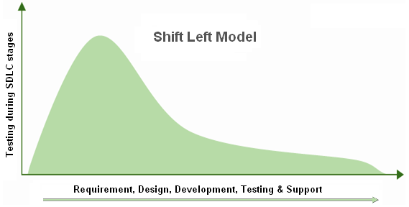
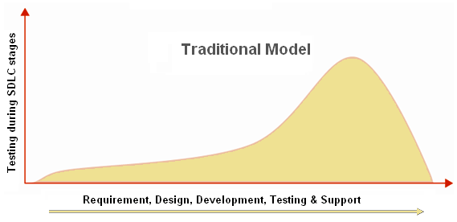
Shift left – what?

Slide 27
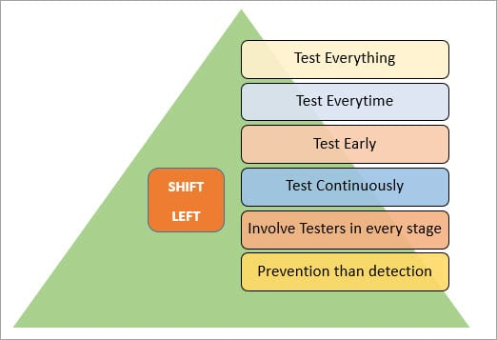
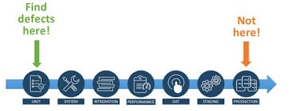
Shift left – how?
Demand planning
Static testing
Unified test strategy
Risk based analysis

Slide 28
When do We Test?
Traditional Approach
Design
Code
Test
Agile Testing Approach
Test
Code
Refactor/
Design

Slide 29
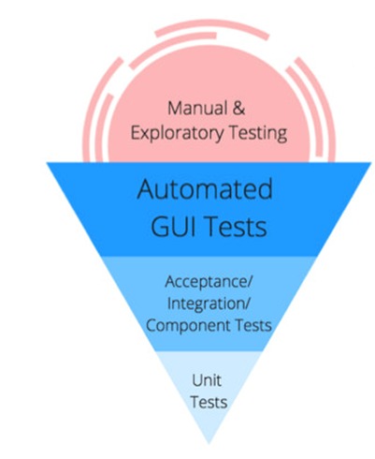
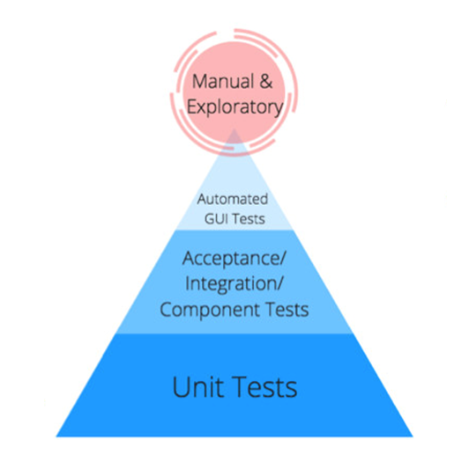
Testing Pyramids
More Time & Effort
Higher ROI

Slide 30
Agile Testing Pyramid
Manual Tests
Time
Brittle
Slower
UI
Tests
System Tests
Integration Tests
Component Tests
Unit Tests
Faster
Cost / Effort
Solid

Slide 31
Agile Testing Strategy
Every build
Unit test
Static, dynamic analysis
Smoke tests
Regression
Functional test
Long running tests
Load/Performance
Security
UI tests
User Acceptance Test (UAT)
Continuous
Daily
Sprint/Weekly
Release

Slide 32
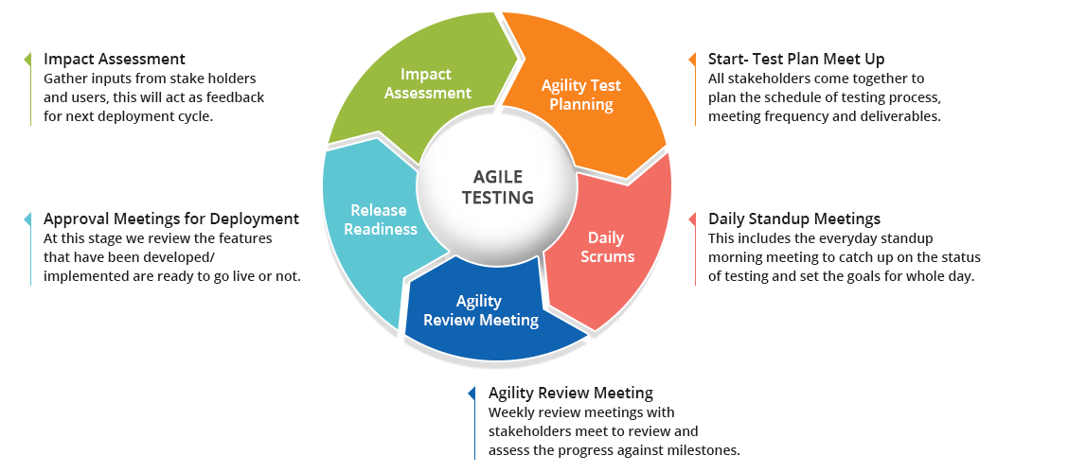
Agile Testing Life Cycle
Impact assessment
Agile Testing Planning
Release Readiness
Daily Scrums
Test Agility Review

Slide 33
Agile Testing Principles
Business First
Everyone can Test
Accelerate the Team
Provide Continuous Feedback
Deliver Value to Customer
Enable face-to-face communication
Have Courage
Keep it Simple
Practice Continuous Improvement
Respond to Change
Self-organize
Focus on people
Enjoy
10 Agile Testing Principles
7 Modern Testing Principles
Data trumps intuition
Always Learn & Improve
Customer is King
Lead a Quality Culture

Slide 34
Agile Testing Quadrants
Manual & Automated
Business Facing
Manual & Automated
Functional Tests
Examples
Story tests
Prototypes
Simulations
Alpha/Beta (A/B) Tests
UI Tests
Exploratory Tests
User Acceptance Tests (UAT)
Cross Browser Tests
Usability Tests
Workflows/Scenarios
Tests that critique the product
Tests that support the team
Unit Tests
Component Tests
System Integration Tests
Performance & Load Tests
Security Tests
Accessibility Tests
Database
Quality Attributes (ility) Testing
Automated
Tools Automation
Technology Facing

Slide 35
Agile Testing - Test First Development
Junit, TestNG, Jasmine, Cucumber
Tools
TDD, BDD, ATDD
Realization/Adoption
Approaches, Techniques
Realization/Adoption
Test First Development
Philosophy, Practice

Slide 36
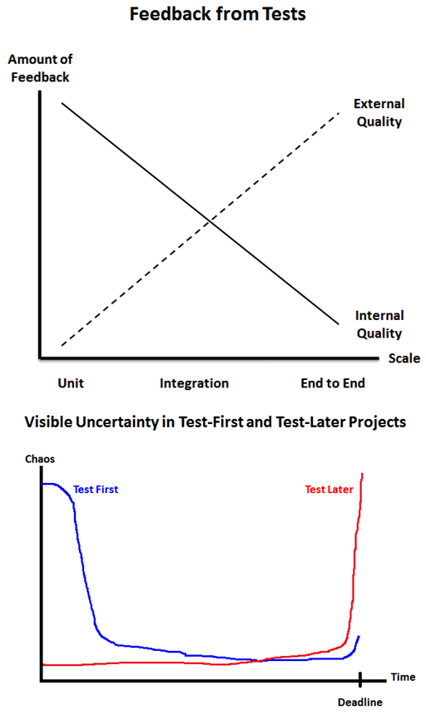
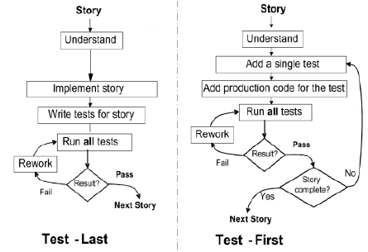
Test First vs Test Last

Slide 37
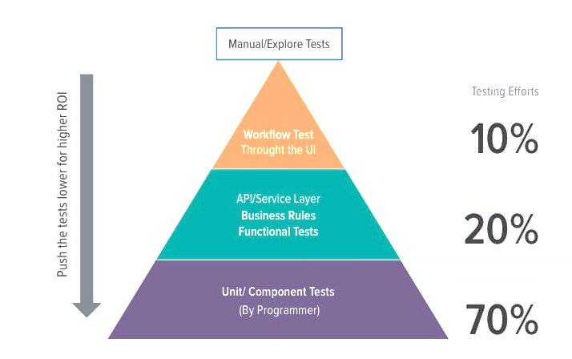
Agile Testing Efforts

Slide 38
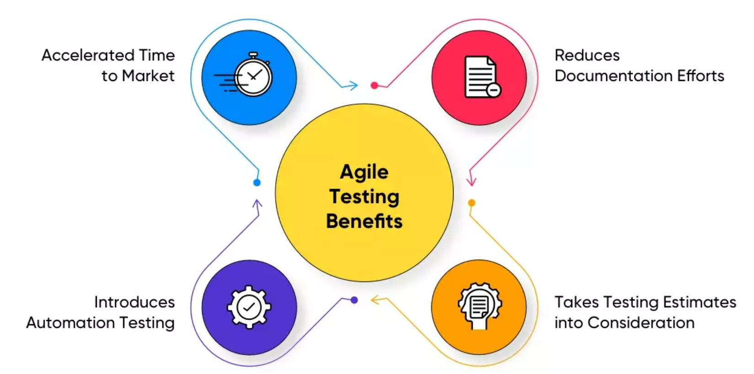
Agile Testing Benefits
Early testing form initial phases
Cohesion between developers and testers means that quality is at the forefront of everyone’s minds
Lightweight documentation - focus is not on writing multiple test plans, test cases, test reports, bug reports, but on making sure that the solution is of high quality

Slide 39

Agile Testing Challenges
Insignificant/Incomplete Information
Continuous Testing
Slow Feedback Loop
Frequently Changing Requirements
Unclear Quality Measurement Criteria
Early Detection of Defects
Performance Bottlenecks

Slide 40


Activity – Change your process; change your quality
20 minutes
Part 1: Visualize your current software development lifecycle (SDLC) using a pen and paper or diagramming tool. Try to capture each of the activities in your SDLC and how they flow into one another. Here is an example diagram to help you get started:
Planning
Development
Testing
Deployment
Monitoring
Part 2 : Next, create a second diagram that would describe your ‘dream’ SDLC flow where the whole team has ownership of quality. You can add new activities, add responsibilities or re-arrange your SDLC process.
Part 3 : Comparing your two SDLC processes, write down three small experiments/ideas that you could try out as a team to help nudge you towards whole team ownership of quality.

Slide 41
Software Testing Tools and Techniques

Slide 42
Manual Testing
In manual testing , testers manually execute test cases without using any automation tools.
It requires a tester to play the role of an end user.
Any new application must be manually tested before its testing can be automated.
Manual testing requires more effort, but is necessary to check automation feasibility.
Manual testing does not require knowledge of any testing tool.
One key software testing principle is 100% Automation is not possible making manual testing imperative and important.

Slide 43
Advantages of Manual Testing
It is preferable for products with short life cycles.
It is preferable for products that have GUIs that constantly change.
It requires less time and expense to begin productive manual testing.
Automation can not replace human intuition, inference, and inductive reasoning- yet.
Automation can not change course in the middle of a test run to examine something that had not been previously considered.
Automation tests are more easily fooled than human testers - yet.

Slide 44
Limitations of Manual Testing
Requires more time or more resources, sometimes both - especially for long running projects.
Performance testing is impractical with manual testing.
Less Accurate.
Executing same tests again and again is time consuming and tedious.
Not Suitable for Large scale projects and time critical projects.
Batch Testing is not possible as for every test execution human user interaction is mandatory.
Scope of manual test cases is very limited.
Comparing large amounts of data is impractical.
Checking relevance of search of operation is difficult.
Processing change requests during software maintenance takes more time.

Slide 45
Why Automated Testing?
Challenging to test multilingual sites/interfaces manually.
Does not require human intervention.
Increases speed of test execution.
Increase test coverage exponentially.
Manual testing can become boring for testers and hence is error prone.

Slide 46
Automation Testing vs. Manual Testing
Automation Testing | Manual Testing
Perform same operation each time | Test execution is not accurate all the time, hence not reliable
Useful to execute a set of test cases frequently | Useful when the test case only needs to run once or twice
Fewer testers required to run test cases | Large number of testers required
Platform independent | Platform dependent
Testers can fetch complicated information from code | Does not involve any programming task to fetch hidden information
Faster | Slower
Not helpful in testing UI | Helpful in testing UI
High cost | Less than automation

Slide 47
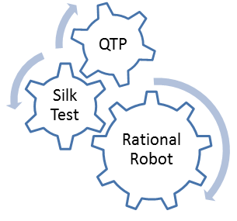
Automation tools
Some of the most popular test tools

Slide 48
QTP (Quick Test Professional)
HP's Quick Test Professional (now known as HP Functional Test) is the market leader in Functional Testing Tool space.
It supports keyword driven testing.
Suitable for both client/server and web-based applications.
QTP has better error handling mechanism than most tools.
It offers excellent data driven testing features.

Slide 49
Rational Robot
Rational Robot is a complete set of components for automating the testing of Microsoft Windows client/server and internet applications.
The main component lets you start recording tests in as few as two mouse clicks.
After recording, Robot can play back (run) the tests in a fraction of the time it would take to repeat the actions manually.
Enables defect detection and includes test cases and test management.
It supports multiple UI technologies.

Slide 50
Selenium
It is an open-source portable software testing framework for web applications.
It provides a record/playback tool for authoring tests without learning a test scripting language using Selenium IDE.
It supports writing tests in a test domain-specific language - including in C#, Groovy, Java, Perl, PHP, Python, and Ruby.
The tests can then be run against most modern web browsers.
It can be deployed on all major platforms - Windows, Linux, and Macintosh.

Slide 51
SilkTest
SilkTest is an automated function and regression testing tool for enterprise applications.
It is used for testing e-business applications.
It offers test planning and management, direct database access and validation support.
It supports extensions for .NET, Java (Swing and SWT), DOM, IE, Firefox, and SAP Windows GUI.

Slide 52
Benefits of Automated Testing
Reliable: Tests perform precisely the same operations each time they are run, thereby eliminating human error.
Repeatable: You can test how the software reacts under repeated execution of the same operations.
Programmable: You can program sophisticated tests that bring out hidden information from the application.
Comprehensive: You can build a suite of tests that covers every feature in your application.
Reusable: You can reuse tests on different versions of an application, even if the user interface changes.
Fast: Automated tools run tests significantly faster than human users - approx. 70% faster than manual testing!
Better Quality Software: Because you can run more tests in less time with fewer resources
Cost Reduction: As the number of resources for regression test are reduced.

Slide 53
Automated test tool features
Essential
Highly Desirable
Nice to Have

Slide 54
Essential
The ability to divide the script into a small number (3 or 4) of repeatable modules.
Supports the use of multiple data sheets/tables (at least 8).
The ability to store objects names in data tables and refer to them in the script.
The ability to treat the contents of different cells in data sheets as input data, output data, windows, objects, functions, commands, URLs, executable paths, commands, etc.
The ability to access any data sheet from any module.

Slide 55
Highly Desirable
The ability to recover from Severity 1 (fatal) errors and still continue to the end.
The ability for the users to create custom functions.
The ability to write directly into the results report.
The ability to write into the data table (using a script).

Slide 56
Nice to Have:
Direct interface to the test management system (bi-directional).
The ability to add comments to data table (rows).
The ability to restrict output to the results file .

Slide 57
Static Test Tools
Static analysis tools are generally used by developers as part of the development and component testing process.
They can help developers to understand the structure of the code.
They can also be used to enforce coding standards.
These tools do not involve actual input and output.
Static analysis tools are an extension of compiler technology.

Slide 58
Features for Selecting Static Test Tools
Assessment of the organization’s maturity (e.g. readiness for change).
Identification of the areas where tool support will help improve testing processes.
Evaluation of tools against clear requirements and objective criteria.
Evaluation of the vendor (training, support and other commercial aspects) or open-source network of support.
Identifying and planning internal implementation team (including coaching and mentoring for those new to the use of the tool).

Slide 59
Dynamic analysis tools
Dynamic because they require the code to be in a running state.
They analyze what is happening behind the scenes - that is in the process and its runtime env. while the software is running.
These tools are used by developers in component testing and component integration testing.
E.g.: Testing of middleware and security policies, or when looking for robustness defects.

Slide 60
Features of Dynamic Test Tools
Detect memory leaks.
Identify pointer arithmetic errors such as null pointers.
Identify time dependencies.
Test the software system with 'live' data.

Slide 61
What is a Testing Framework?
Testing automation framework is an execution environment for automated tests.
It is the overall system in which the tests will be automated.
It is defined as the set of assumptions, concepts, and practices that constitute a work platform or support for automated testing.
It is application independent.
It is easy to expand, maintain and perpetuate.

Slide 62
Why we need a Testing Framework
Suppose if each project implements a unique strategy then the time needed for a tester to become productive in the new environment will take long. To handle this we cannot make changes to the automation environment for each new application that comes along.
A testing framework can be of particular help here as they are application independent and have the capability to expand with the requirements of each application.
A testing framework helps avoid duplication of automated test cases across the application.
They also help teams organize their test suites and improve the testing efficiency.

Slide 63
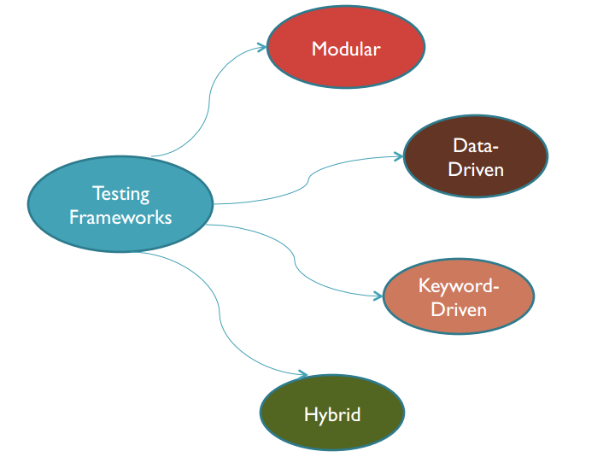
Types Of Testing Frameworks

Slide 64
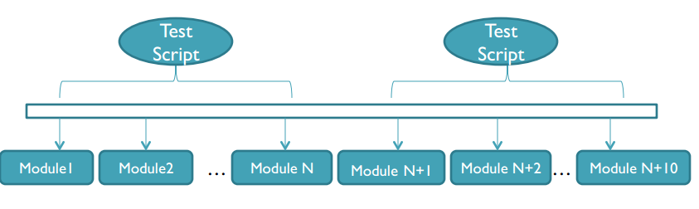
Modular Testing Framework
The Modular testing framework is built on the concept of abstraction.
Creates independent scripts representing the modules of the application under test.

Slide 65
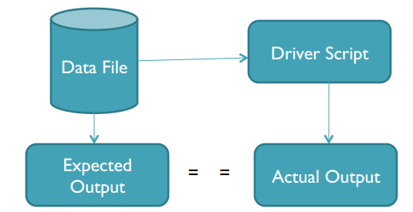
Data-Driven Testing Framework
Data driven testing is where the test input and the expected output results are stored in a separate data file (normally in a tabular format) so that a single driver script can execute all the test cases with multiple sets of data.
The driver script contains navigation through the program, reading of the data files and logging of the test status information.

Slide 66
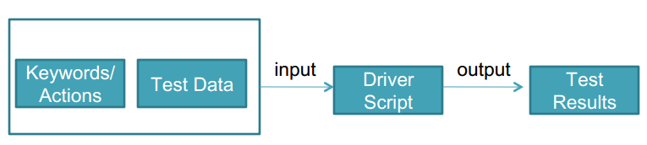
Keyword- Driven Testing Framework
Keyword driven testing is an application independent framework utilizing data tables and self explanatory keywords to explain the actions to be performed on the application under test.
The test data kept in an external file as are the directive test scripts.
These directives are called keywords.

Slide 67
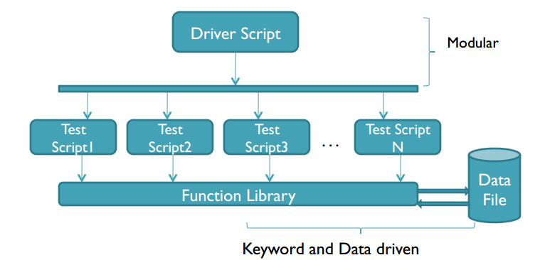
Hybrid Testing Framework
Hybrid testing framework is the combination of modular, data-driven, and keyword-driven testing frameworks.
It helps the data driven scripts take advantage of the libraries mostly used in keyword driven testing.

Slide 68




Thank you!
Notes:
Mandatory -- Need bookend -- first and last thing they should see is DevelopIntelligence
ACTION: Use this for the final slide of your class materials.

